Slide 1
JAVA
Programming Constructs

Slide 2
Sequential Construct
Code is executed line by line, in the order written.
int a = 5;
int b = 10;
int sum = a + b;
System.out.println("Sum: " + sum);

Slide 3
Conditional Construct Decision-making
Decision-making involves evaluating a condition to a Boolean value and making a decision based on it. The basic idea revolves around executing the block of code whose condition evaluates to true. Below are the types of decision-making statements:
if statement
if…..else statement
if…..else if statement
nested if statements
switch statement

Slide 4
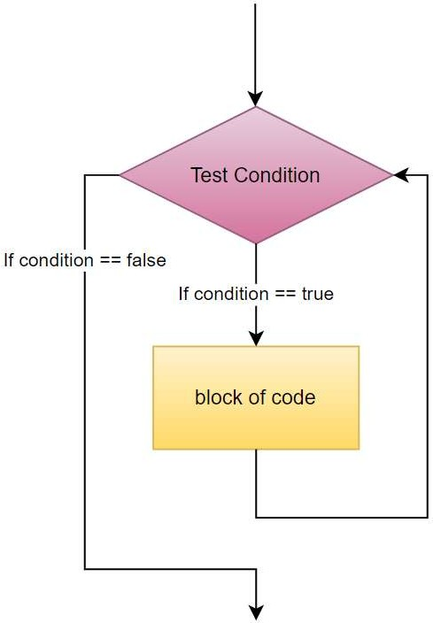
if statement
It is also known as a one-way selection statement. If a condition is used, an argument is passed, and if it is satisfied, the corresponding code is executed; otherwise, nothing happens.
Syntax:
if (condition)
{
//block of code
}

Slide 5
Example :
public class JavaIf
{
public static void main(String[] args)
{
String name = "Mohan"; int Roll = 25;
if (name == "Mohan" && Roll == 25)
{
System.out.println("Details of Mohan.");
}
}
}

Slide 6
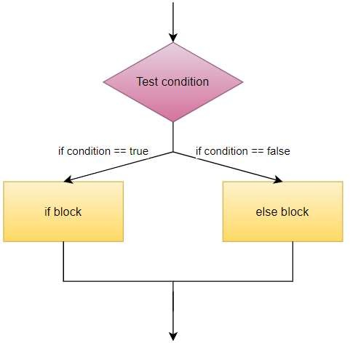
if…..else Statement
In an if…..else statement we have two blocks of code, wherein the former block of code (code inside if statement) is executed if condition evaluates to true and the later block of code (code inside else statement) is executed if the condition is false
Syntax:
if (condition)
{
//block of code
} else
{
//block of code }

Slide 7
Task: Even or Odd Number Check Objective: Practice using if-else statements. Instructions:
Write a Java program that takes an integer input from the user.
Check if the number is even or odd using an if-else statement.
Print the result.

Slide 8
Example :
import java.util.*; class sample {
public static void main(String[] args)
{
int a = 10;
if (a % 2 == 0)
{
System.out.println(a + " is an even number");
}
else
{
System.out.println(a + " is an odd number");
}
} }

Slide 9
Scanner scanner = new Scanner(System.in);
Reading int
System.out.print("Enter a number: ");
int num = scanner.nextInt();
Reading Strings
String word = scanner.next(); // e.g., Hello
String line = scanner.nextLine(); // e.g., Hello World!
next() → reads one word (stops at space)
nextLine() → reads the entire line, including spaces
double price = scanner.nextDouble();
boolean flag = scanner.nextBoolean();
char ch = scanner.next().charAt(0);

Slide 10
import java.util.Scanner;
public class EvenOddChecker {
public static void main(String[] args) {
Scanner scanner = new Scanner(System.in); System.out.print("Enter an integer: ");
int number = scanner.nextInt();
if (number % 2 == 0) {
System.out.println(number + " is even.");
} else {
System.out.println(number + " is odd.");
}
scanner.close();
}
}

Slide 11
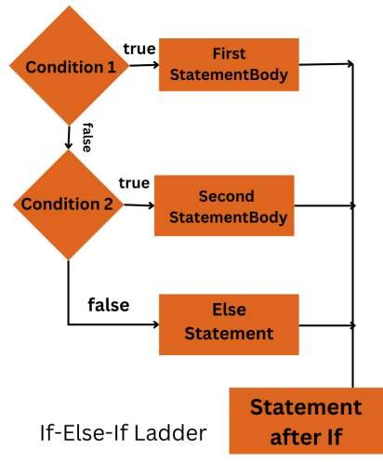
if…..else if Statement
But what if we have more than two blocks of code? And what if we need to check which block of code evaluates to true? Well here we use an if…..else if statement.
if……else if statements allows us to check multiple expressions and enter the block of code where the condition evaluates to true.
Syntax:
if (condition 1)
{ //block of code }
else if (condition 2)
{ //block of code } else if (condition 3)
{ //block of code }
else if (condition 4)
{ //block of code }
else { //if no condition matches //block of code }

Slide 12
Example :
import java.util.*; class sample
{
public static void main(String[] args)
{
int i = 3; if (i == 1)
System.out.println("January"); else if (i ==2) System.out.println("February") else if (i==3) System.out.println("March"); else System.out.println("April");
} }

Slide 13
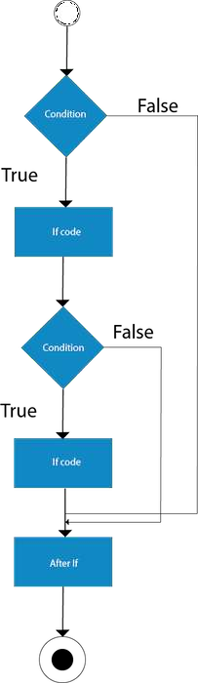
Nested if Statements
If conditions inside another if conditions are called as Nested If conditional statements in java..
Syntax :
if (condition1)
{
// Statement 1 will execute
if (condition2)
{
// Statement 2 will execute
} }

Slide 14
Example :
public class JavaNestedIfExample
{
public static void main(String[] args)
{
//Creating two variables for age and weight
int age=20;
int weight=80;
//applying condition on age and weight
if(age>=18){ if(weight>50){
System.out.println("You are eligible to donate bloo
d");
}
}
}}

Slide 15
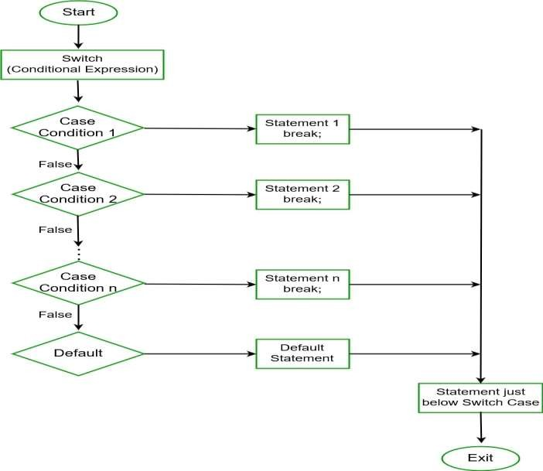
switch case Statements
In a switch statement, a block of code is executed from many based on switch case.
Syntax:
switch (expression)
{
case value1:
// code break; case value2:
// code break;
... ... default:
// default statements
}

Slide 16
Example :
public class JavaSwitch {
public static void main(String[] args) {
String day = "Wednesday";
switch (day) { case "Sunday":
System.out.println("Today is Sunday");
break;
case "Monday": System.out.println("Today is Monday"); break;
case "Tuesday": System.out.println("Today is Tuesday"); break;
case "Wednesday": System.out.println("Today is Wednesday"); break;
}
}
}

Slide 17
Looping Construct Iteration Statements
Loops in any programming language are used to execute a block of code again and again until a base condition is achieved. As soon as a base condition is satisfied the loop is terminated and the control is returned to the main body of the program.
There are three types of loops in java:
for loop
while loop
do…while loop

Slide 18
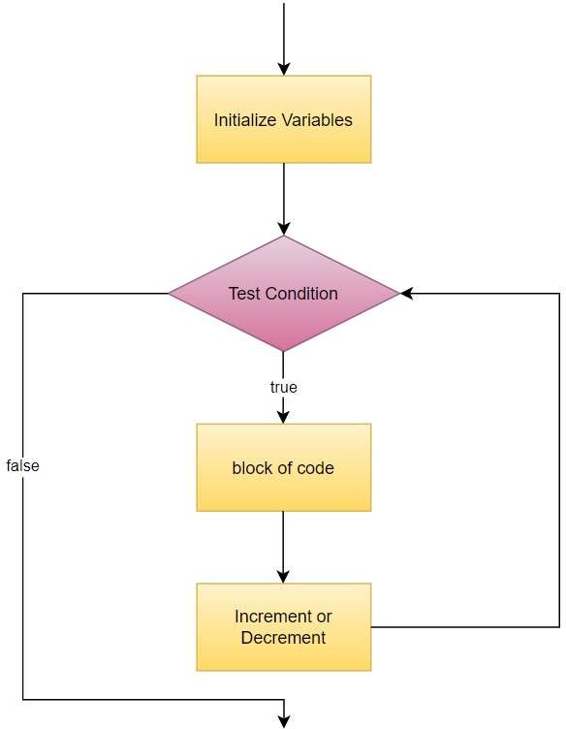
for loop
The for loop is used when the number of iterations is known beforehand.
Syntax:
for (initializeVariable, testCondition, increment/decrement)
{
//block of code
}
InitializeVariable: initialize a new variable or use an already existing
one.
TestCondition: It checks the testing condition of the loop after each iteration and returns a Boolean value, which determines if the loop should be terminated or not.
Increment/decrement: It is used to increment or decrement the variable after each iteraton.

Slide 19
public class Main
{
Example :
public static void main(String[] args)
{
// A for loop that prints numbers from 1 to 5 for (int i = 1; i <= 5; i++)
{
System.out.println("Number: " + i);
}
}
}

Slide 20
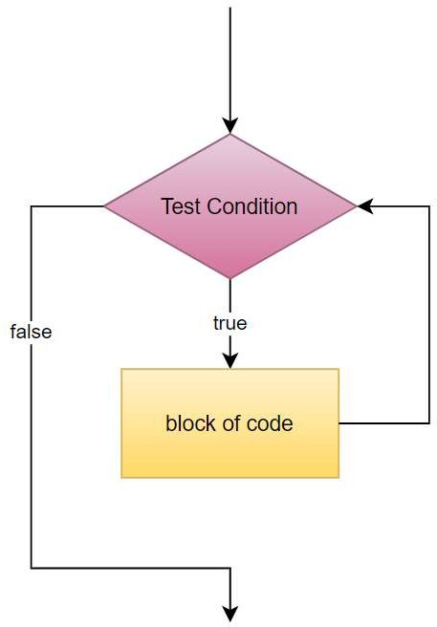
while Loop
Whenever we are not sure about the number of times the loop needs to
be run, we use a while loop.
A while loop keeps on running till the condition is true, as soon as the condition is false, control is returned to the main body of the program.
A while loop is considered an entry control loop because it checks the condition before executing the loop body. If the condition is false, first statement following the loop is executed.
Syntax:
while (baseBooleanCondition)
{
//block of code
}

Slide 21
Eg:
public class WhileLoop
{
public static void main(String[] args)
{
int i = 10; while (i>0)
{
System.out.println(i); i--;
}
}
}

Slide 22
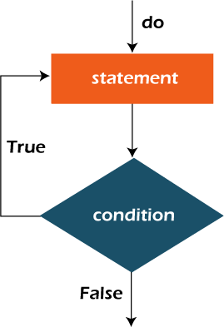
Do-while Loop
When you need the loop body to be executed at least once regardless of the condition.
A do…..while loop is a special kind of loop that runs the loop at least once
even if the base condition is false.
Hence, do…..while loop is also called as an Exit Control Loop.
Syntax:
do
{
//block of code
}
while (baseBooleanCondition);

Slide 23
Example :
public class WhileLoop
{
public static void main(String[] args)
{
int i = 10; do
{
System.out.println(i); i--;
}
while (i>10);
} }

Slide 24
Nested For Loop
What is a Nested for Loop?
A nested for loop in Java is a loop inside another for loop.
The outer loop controls the number of times the inner loop runs.
It is commonly used for 2D structures, like matrices, patterns, or tables.

Slide 25
Nested For Loop
Syntax of Nested for Loop
for (initialization; condition; update)
{
for (initialization; condition; update)
{ // inner loop code
}
// outer loop code
}

Slide 26
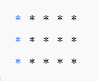
Nested For Loop
public class NestedForLoopExample { public static void main(String[] args) {
for (int i = 1; i <= 3; i++) { for (int j = 1; j <= 5; j++) {
System.out.print("* ");
}
// outer loop: rows
// inner loop: columns
System.out.println(); // move to next line after each row
}
}
}

Slide 27
Jump Statements
In Java, a jump statement is used for transferring the control of the program from one particular point to another point of the program, allowing for changes in the flow of execution.
"Jump Statements" are also called "Branching Statements in Java" as they evaluate different branches to enhance the flow of the execution.

Slide 28
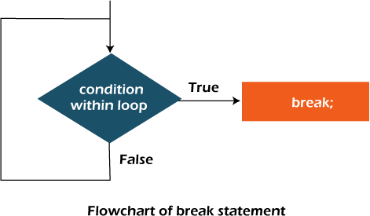
Break statement
A break statement
in Java assists in
terminating the execution of a loop in a particular program.
This statement transfers the control of the program to the next statement which is immediately after the current loop or switch.
A break statement is used in an existing statement of a loop, especially an infinite loop, to exit from it.
There are 3 types of Break Statements, those are "Exiting a Loop", "As a form of Goto", and "In a switch case".

Slide 29
Use Break to Exit a Loop
Eg:
class break_statement
{
public static void main(String[] args)
{
int i;
for (i=10;i>=0;i--)
{
if (i==5)
{
break;
}
else
{
System.out.println(i);
}
} }

Slide 30
Use Break in a Switch case
class Switch_Case
{
public static void main(String[] args)
{
char a = 'C';
switch (a)
{
case 'A':
System.out.println("Letter A");
break; //break statement to come out of switch
case 'C': System.out.println("Letter C"); break;
default:
System.out.println("Default case: NO Letter Matched!");
}
}
}

Slide 31
Use Break in as GoTo
public class BreakAsGoto {
public static void main(String[] args) {
outerLoop: // this is a label
for (int i = 1; i <= 3; i++) {
for (int j = 1; j <= 3; j++) {
System.out.println("i=" + i + ", j=" + j);
if (i == 2 && j == 2) {
break outerLoop; // acts like a goto to jump out of both loops
}
}
}
System.out.println("Exited both loops using labelled break.");
}
}

Slide 32
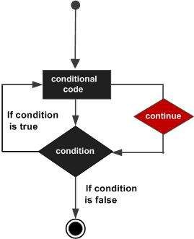
Continue statement
The continue statement in Java never terminates the execution of any loops.
It can only work inside the "loop statement".
The primary job of the "Continue statement" is the iteration of that specific loop.
Continue statement assists the bypass of all the other statements by making them fall under it.
The nature of the Continue statement is to skip
the current iteration and force for the next one

Slide 33
Example :
class continue_statement
{
public static void main(String[] args)
{
for(int i=0; i<=10;i++)
{
if (i<3)
{
Continue; //continues and goes to next iteration
}
System.out.println(i);
} } }

